Slide 1

National University Of Modern Languages
Project:
Programming Fundamentals
Aniqa Jamil SP23868
Zulqarnain Haider SP23859
Hamna Khan SP23856
Jahan Zaib SP23870
Rania Nisar SP23891
Nimra Nisab SP23869

Slide 2
Five-In-One Arcade

Slide 3

Introduction:
In this program, we developed an interactive application that allows users to select and play one of five classic games. Upon launching the program, the user is presented with a menu to choose which game they want to play. The five games included are Hangman, Pac-Man, Rock-Paper-Scissors, Tic-Tac-Toe, and a Number Guessing Game. Each game provides a unique and engaging experience, ensuring a variety of entertainment options.

Slide 4
Game Selection Program:
This program allows users to select and play one of five different games. Upon starting the program, the user is prompted to choose from the following games:
1. Hangman
2. Pac-Man
3. Rock-Paper-Scissors
4. Tic-Tac-Toe
5. Number Guessing Game

Slide 5

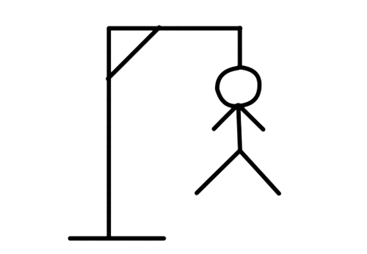
Hangman:
Description: The user tries to guess a hidden word by suggesting letters within a certain number of attempts. Each incorrect guess results in a part of the hangman being drawn.
Logic and Libraries: Utilizes random word selection and user input handling. The “random” library is used for selecting words, and basic input/output operations manage user interactions.

Slide 6

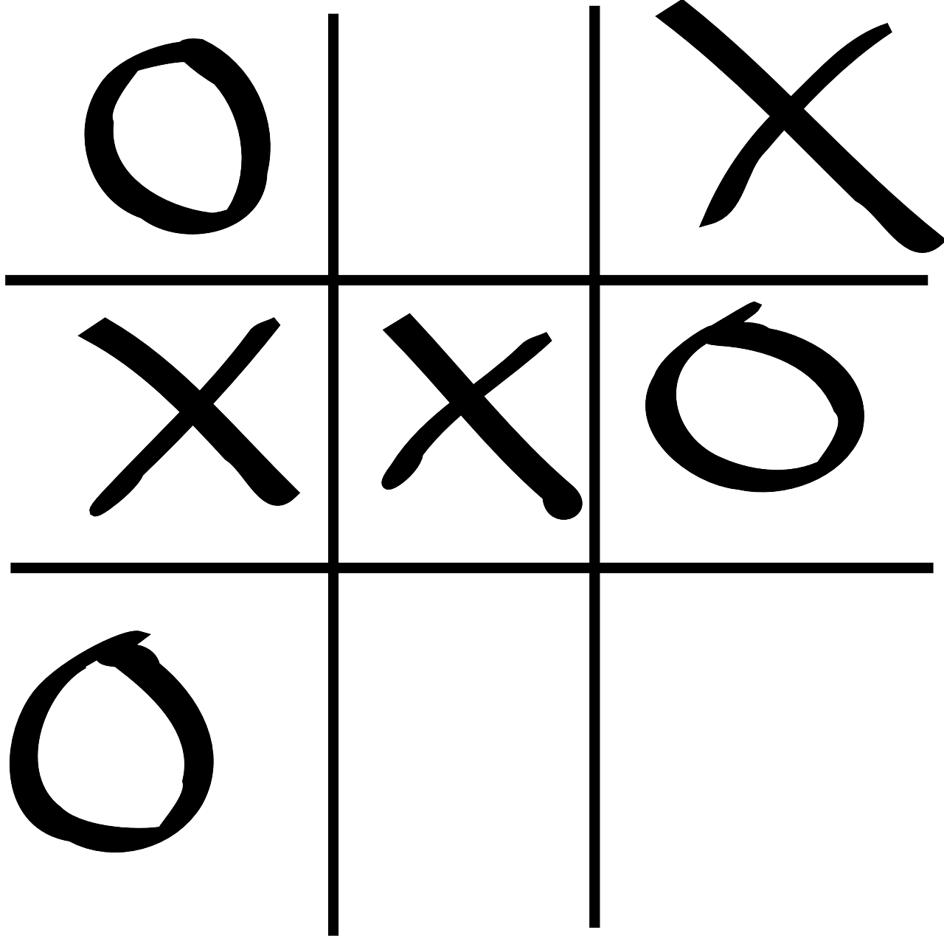
Tic-Tac-Toe:
Description: A two-player game where users take turns marking spaces in a 3x3 grid. The first player to get three of their marks in a row (vertically, horizontally, or diagonally) wins.
Logic and Libraries: Manages a 3x3 grid, checks for win conditions, and handles turn-based gameplay using basic input/output operations, with optional use of “numpy” for grid management.

Slide 7

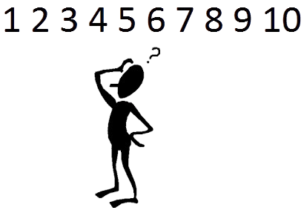
Number Guessing Game:
Description: The user tries to guess a randomly selected number within a specified range. Feedback is provided after each guess to indicate whether the guess is too high, too low, or correct.
Logic and Libraries: Employs random number generation and user input handling, with feedback based on conditional statements. The `random` library generates the target number.

Slide 8
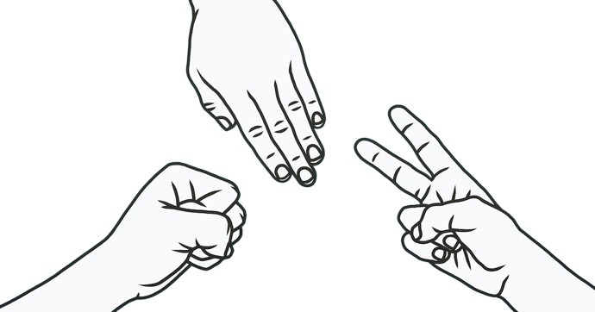
Rock-Paper-Scissors:
Description: A simple game where the user selects rock, paper, or scissors, and the computer randomly selects one as well. The winner is determined based on standard rules (rock beats scissors, scissors beats paper, paper beats rock).
Logic and Libraries: Uses user input and random computer choice with
conditional statements to determine the winner. The `random` library facilitates the computer’s choice.

Slide 9
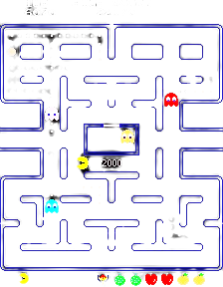
Pac-Man:
Description: The user navigates Pac-Man through a maze, eating pellets and avoiding ghosts. The objective is to eat all the pellets while avoiding being caught by the ghosts.
Logic and Libraries: Implements grid-based movement, collision detection, and used a wide range of extensive libraries like conio.h , windows.h , for functions like sleep and real time keyboard detection.Made specific pseudo algorithm for moving player through x and y coordinates of the screen

Slide 10
Key Points:
Each game has specific limits on tries or rounds.
The game ends when the limits are reached.
Focus on strategy to maximize your success within the given attempts

Slide 11
Feedback and Improvement:
We welcome your feedback to improve the games and add new features.
Share your thoughts on which games you enjoy the most and any suggestions for enhancements.
You can ask if you have any kind of query related to programs.

Slide 12
Thank You
With Love For Mam Mariyam

